Slide 1
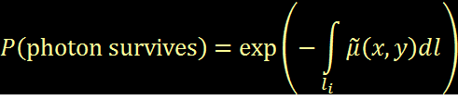
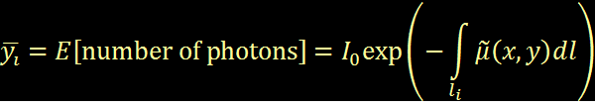
Transmission Tomography
Projection Physics, Beer’s Law
Notes:
Detectability: steep improvement (reduced x-ray scatter)… gradual reduction (increased quantum noise)

Slide 2
Parameterization of the Object
Continuous-domain object
Want finite number of parameters
Voxel Basis
μ₁
μ₂
μ₃
μ₄
μ₅
μ₆
μ₇
μ₈
μ₉
μ₁₀
μ₁₁
μ₁₂
...
...
...
...
...
...
μ_{p}
Notes:
Detectability: steep improvement (reduced x-ray scatter)… gradual reduction (increased quantum noise)

Slide 3
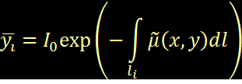
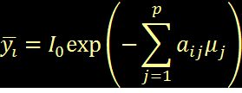

Projection
Linear operation
Discrete-Discrete for parameterized problem
y_{i}
μ_{j-1}
μ_{j}
μ_{j+1}
μ_{j+2}
Notes:
Detectability: steep improvement (reduced x-ray scatter)… gradual reduction (increased quantum noise)

Slide 4

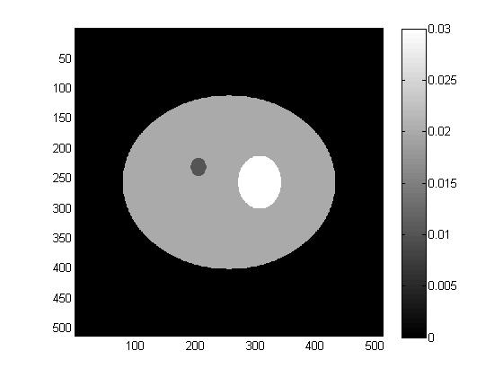
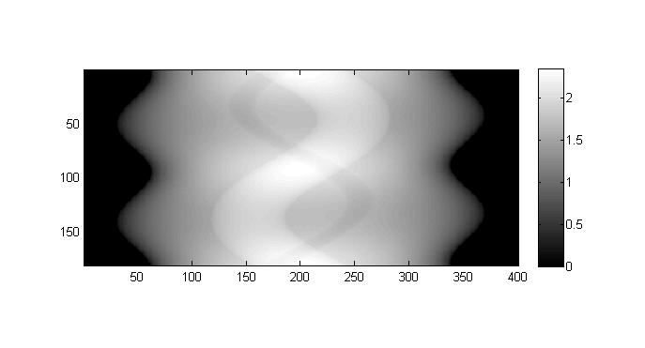
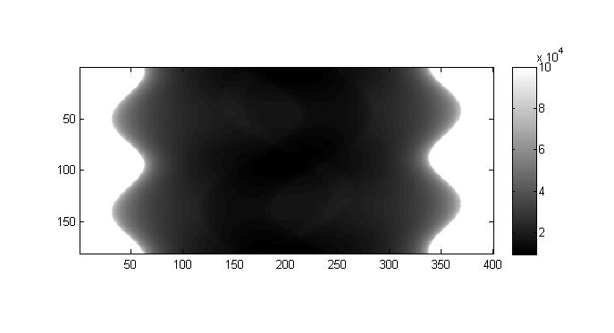


Forward Model
Mean measurements as a function of parameters
Notes:
Detectability: steep improvement (reduced x-ray scatter)… gradual reduction (increased quantum noise)

Slide 5

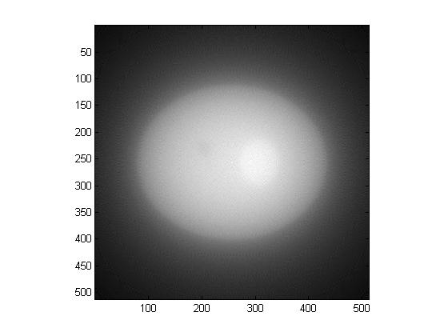
Backprojection
Projection
Backprojection
Notes:
Detectability: steep improvement (reduced x-ray scatter)… gradual reduction (increased quantum noise)

